Slide 1
Native Plants of Walla Walla Basin and the Blue Mountains
Judith S. Johnson
Program Coordinator
Kooskooskie Commons

Slide 2
Thank You
You for taking the time to learn about Walla Native Plants
The Water and Environment Center for hosting the workshop.
Department of Ecology for funding for workshop and stream restoration
Tri-State Steelheaders and Walla Walla County Conservation District partners in the Creating Urban Buffers Program

Slide 3
Partners
Homeowner and other private property partners in stream/riparian restoration.
Washington Department of Fish and Wildlife
Washington Department of Corrections
Walla Walla Basin Watershed Council
Walla Walla Public Schools
Walla Walla Parks and Recreation
Whitman College
Walla Walla College

Slide 4
Native Plants- Why? Where? When? How?
Where can I see them growing/flowering?
Why should I consider planting them in my yard, flower garden or along my creek?
How do I find out where to buy native plants?
When and where do I to plant native plants and how do I care for them.?

Slide 5
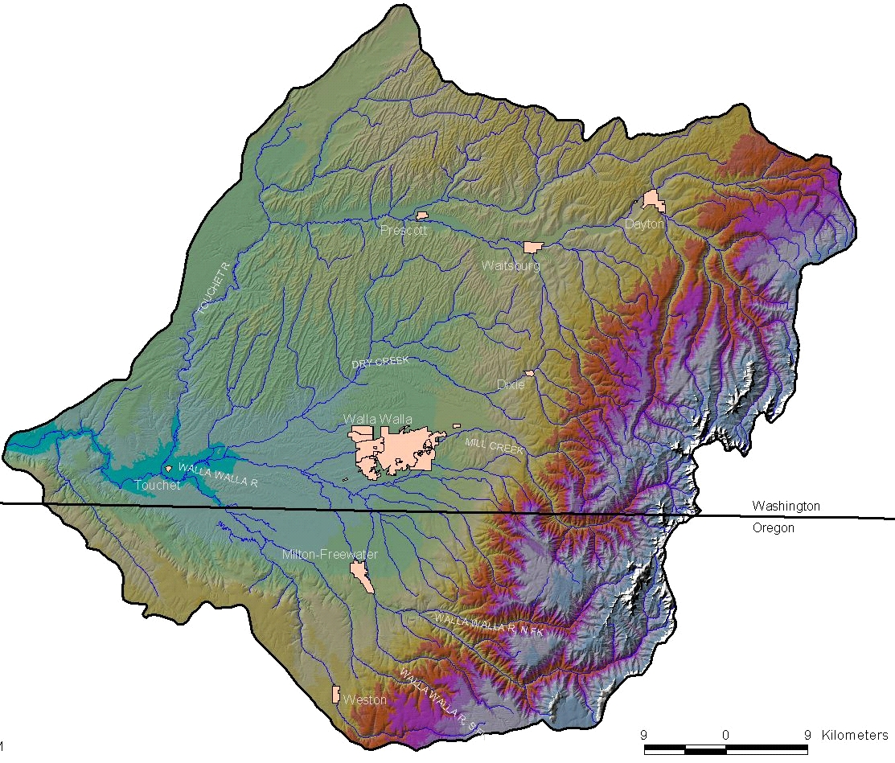
Walla Walla Watershed
Notes:
Walla Walla Watershed Blue Mountains on your right. Columbia River on the left. Snake River at the top. For every mile east of the Columbia River up gradient the average rainfall increases by an inch with the Blue Mountain receiving up to 60 inches of which only 10% leaves in surface water…such as Mill Creek. For the remainder the mountains act as a huge sponge, soaking up the water to refresh the shallow aquifer and store water in the deep basalt aquifers. Soils
At the confluence of the Walla Walla River and the Columbia the loess soils may be 100 ft deep.
At the top of the Blue Mountains, the forest soils are mostly shallow-less than 1 ft.
Sunlight
The lower part of the basin experiences more sunlight and higher temperatures.
At the top of the Blue Mountains the benches and south facing slopes are drier and the north facing slopes more moist.
Weather
Temperatures may be as high as over 100F in mid summer and below 0F in mid winter.
Rainfall is most plentiful from late October to mid to late June.
No substantial rainfall may occur between
July 1 and October 1.

Slide 6
Semi-Arid Desert
Semi-arid desert plants require little water and lots of sun grow in the lower part of the basin near the Columbia River.
A few examples-
Juniper
Sages, rabbitbrush, bitterbrush.
Native bunch grasses
Mallow and Bitterroot
Notes:
Near the confluence of the Walla Walla River with the Columbia River where rain fall is minimal and sunlight is maximum.

Slide 7
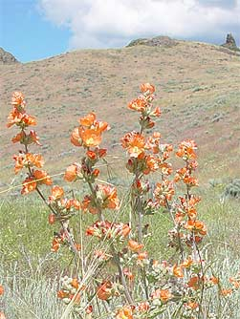
Semi-arid desert landscape
Notes:
Green rabbitbrush and Globe Mallow

Slide 8
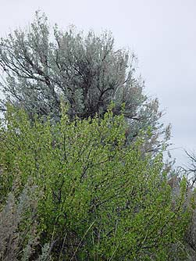
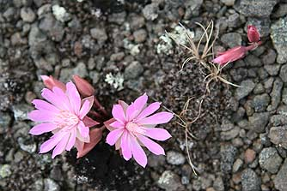
Desert Plants
Notes:
Big Basin Wild Rye-Bitterroot-Bitterbrush and Sage

Slide 9
Riparian
Plants growing in areas along streams do well in both sun and shade. A high water table allows plants to thrive with no supplemental water after roots are established.
A few examples-
Willows, chokecherry, bitter cherry, alder.
Osier dogwood, Woods Rose, Mock orange.
Yellow stream violet, monkey flower, penstemon.

Slide 10
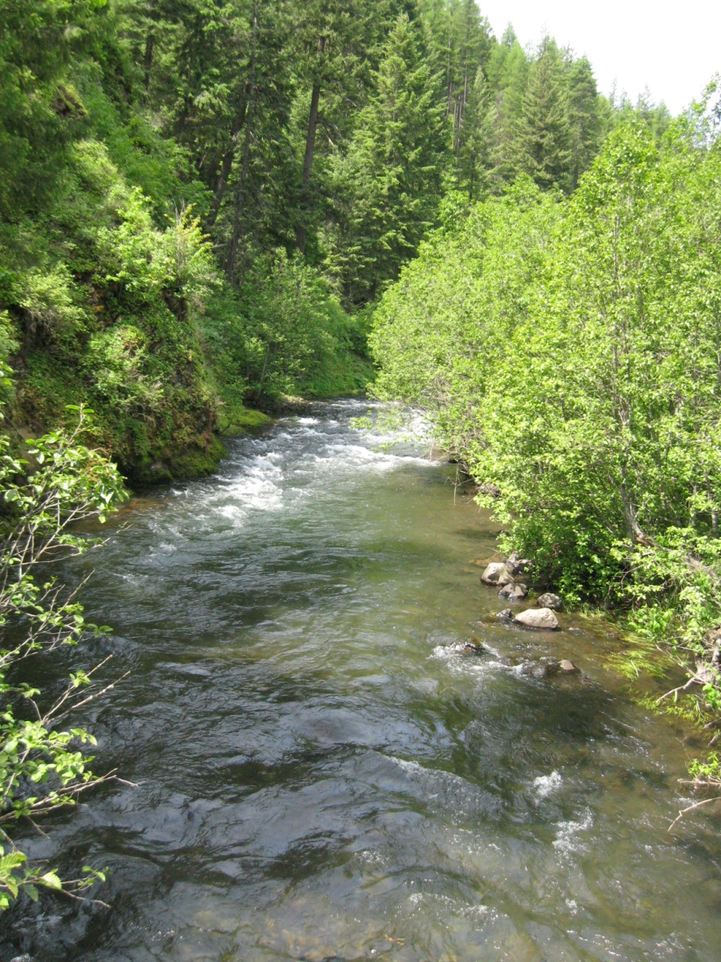
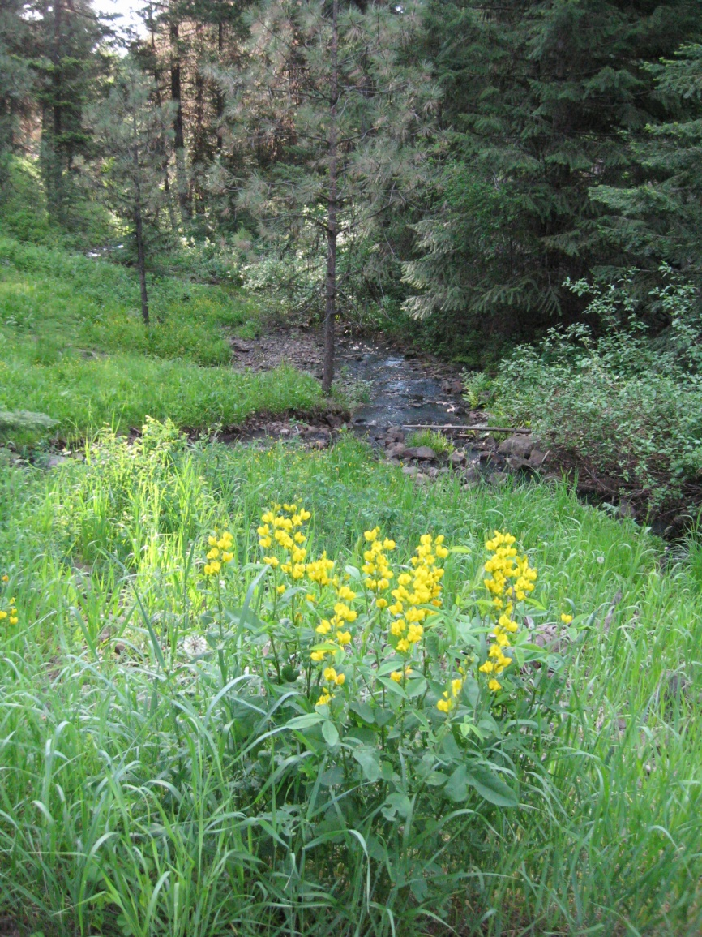
Riparian
Notes:
Looking glass Creek are Scouler willow, Douglas fir and and monkey flower

Slide 11
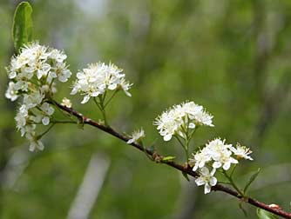
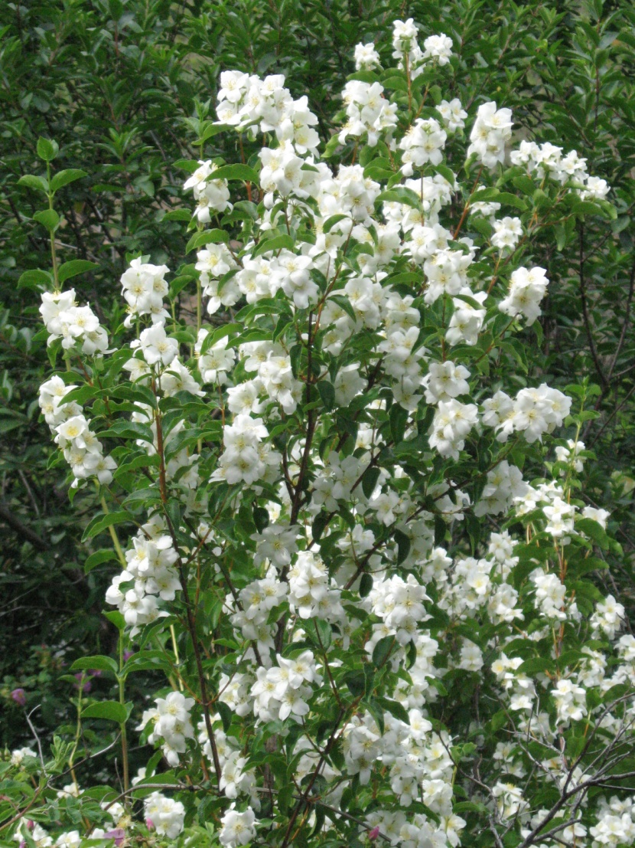
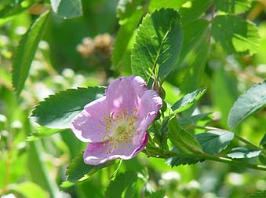
Riparian Plants
Notes:
Common riparian plants and thrive in all elevations of the watershed include serviceberr,y red osier dogwood, wood’s rose and mock orange.

Slide 12
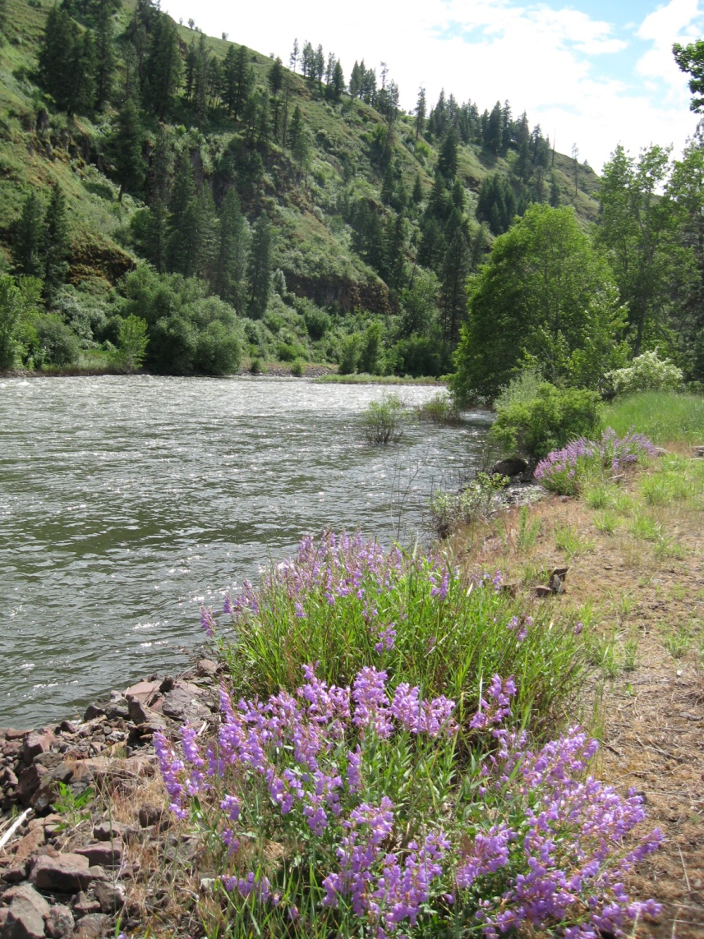
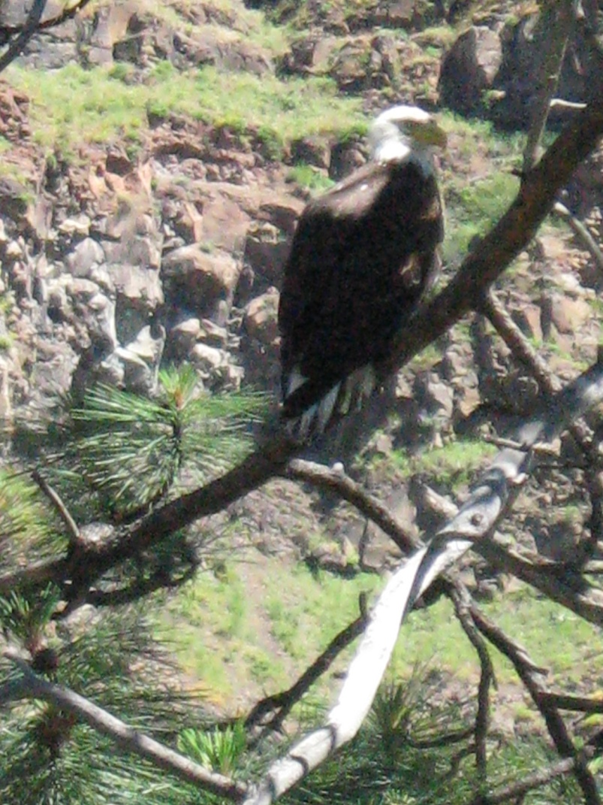
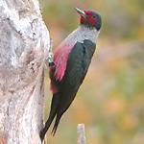
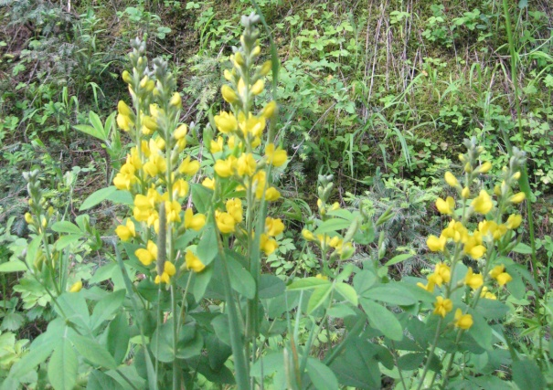
Mountain Rivers
Notes:
Along the Grande Ronde River near its confluence with the Snake River are Penstemon, Ponderosa Pine, Black Cottonwood that provide nesting for Lewis’ woodpeckers and nest sites for bald eagles.

Slide 13
Grassland Meadows Sunlight is abundant with moist soils in the spring gradually drying over the summer.
Arrowleaf Balsamroot
Lupine
Prairie Smoke
Oregon Iris
Sticky Geranium

Slide 14
Grassland Meadows
Notes:
Along the breaks of the Snake River in June

Slide 15
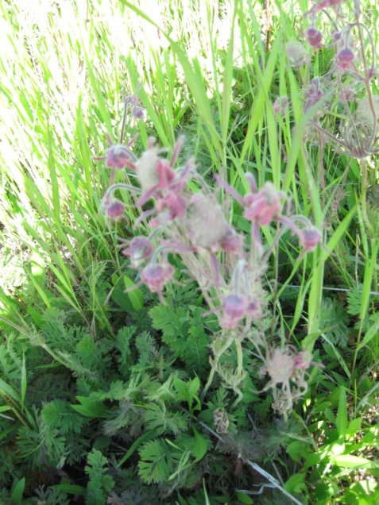
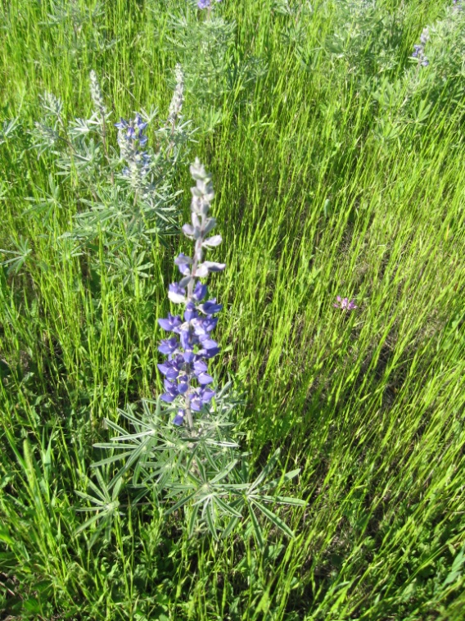
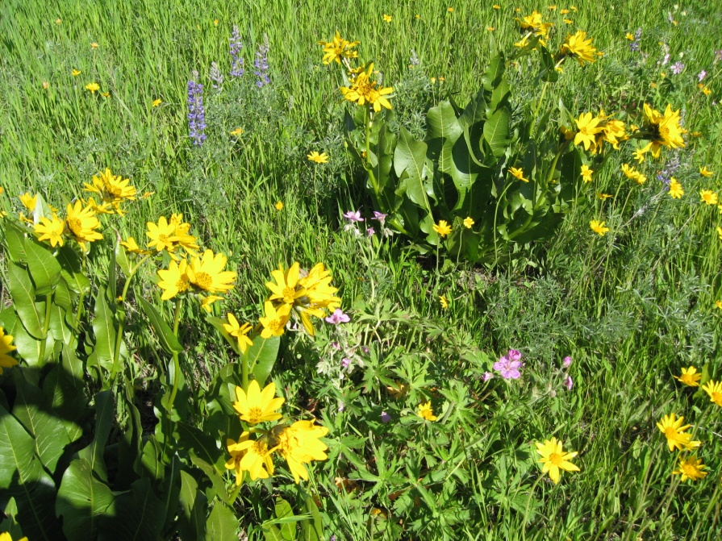
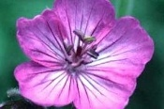
Grassland Meadows
Notes:
Oregon Iris, Lupine, Prairie Smoke, Arrowleaf Balsam Root, Owl Clover

Slide 16
Moist Upland Forest Meadows Marshy meadows surrounded by Old Growth Forests mixed sun and shade.
Red Flowering Currant
Peony
Camas
Yellow violet
Douglas Fir
Engleman Spruce
Quaking Aspen
Skunk Cabbage
Mountain Huckleberry
Notes:
Along the breaks of the Wenaha River

Slide 17
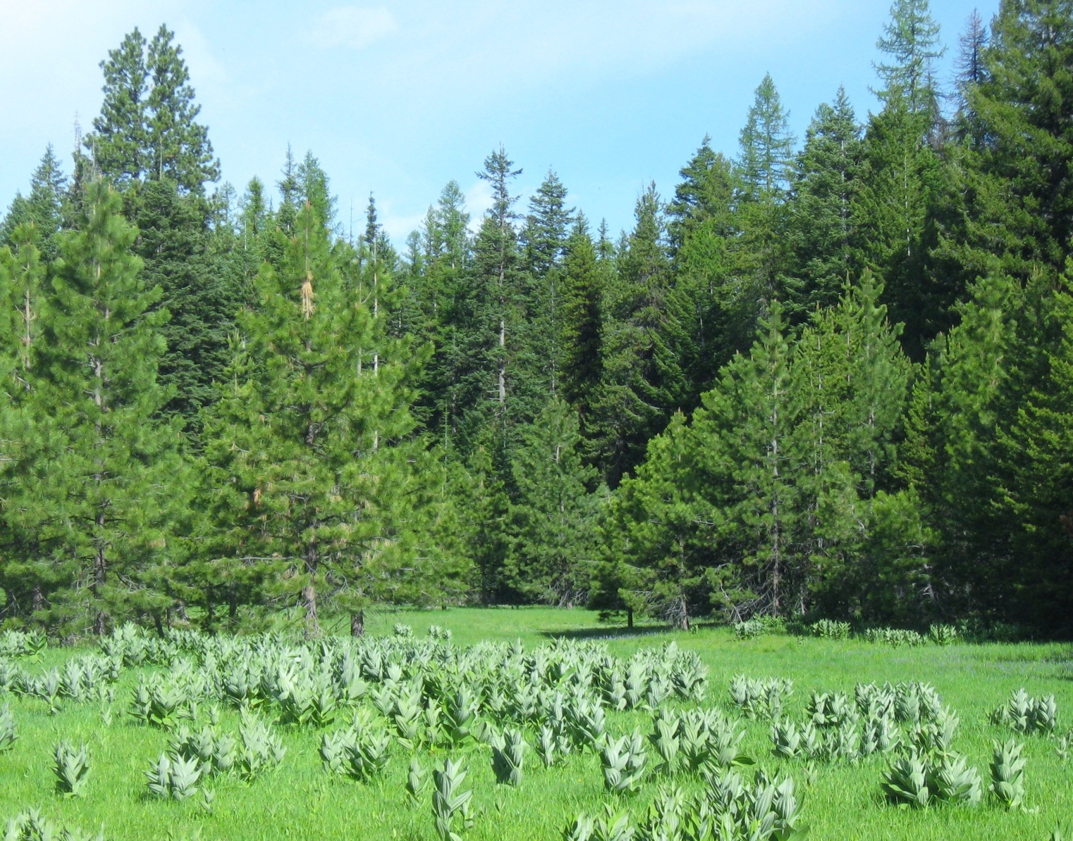
Moist Forest Meadows
Notes:
Skunk Cabbage, Ponderosa Pine Grand Fir, Western Larch

Slide 18
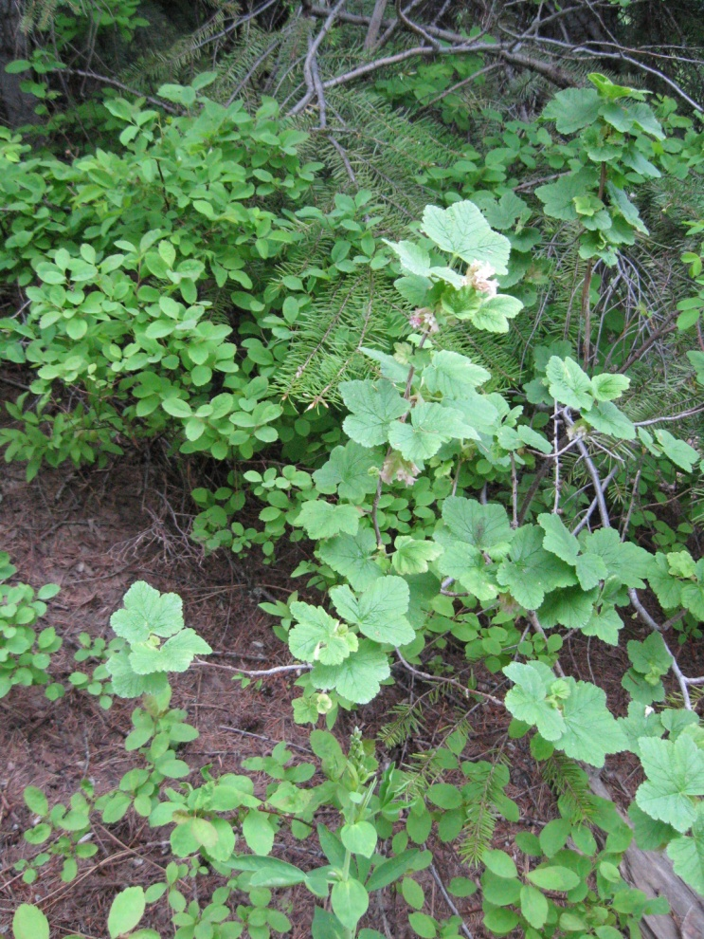
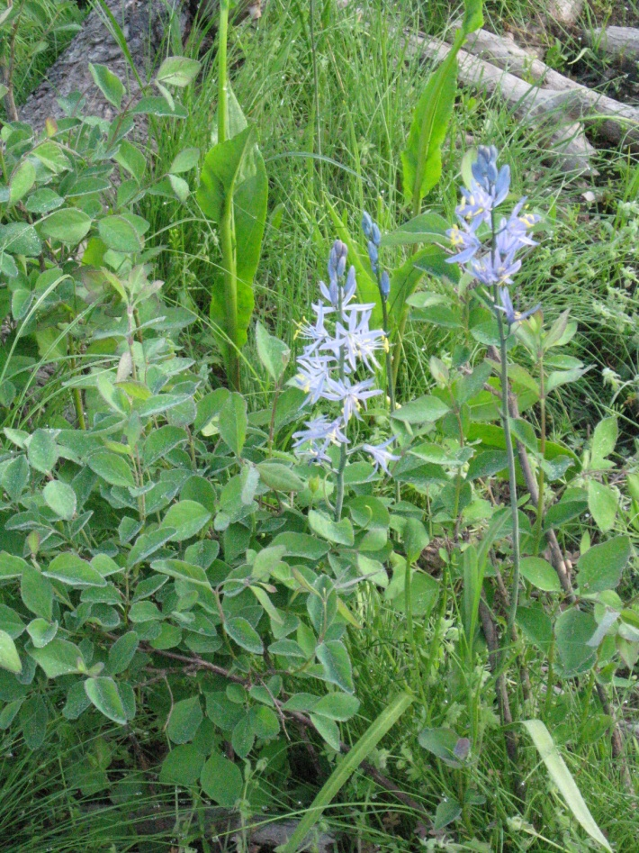
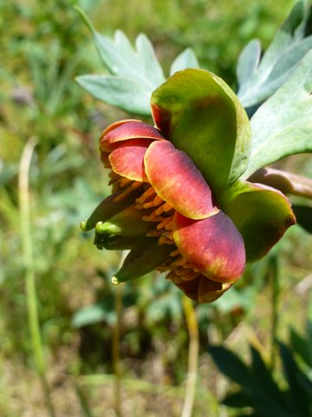
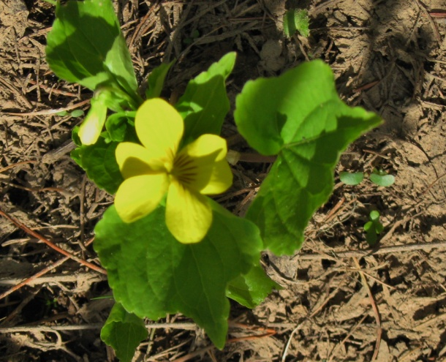
Moist Forest Meadows
Notes:
Mountain Huckleberry, Red flowering currant,Woods Violet, Peony, Camas- Camas roots and huckleberries are traditional women’s foods for local Native American Tribes.

Slide 19
Sunny Forest Slopes Where high elevation captures more snowpack and shallow soils, become dry over the summer.
Ponderosa Pine
Golden Currant
Pacific Ninebark
Scarlett Gilia
Columbine
Blue Mt Penstemon
Owl Clover

Slide 20
Sunny Forest Slopes
Notes:
Looking down into the Wenaha River Canyon

Slide 21
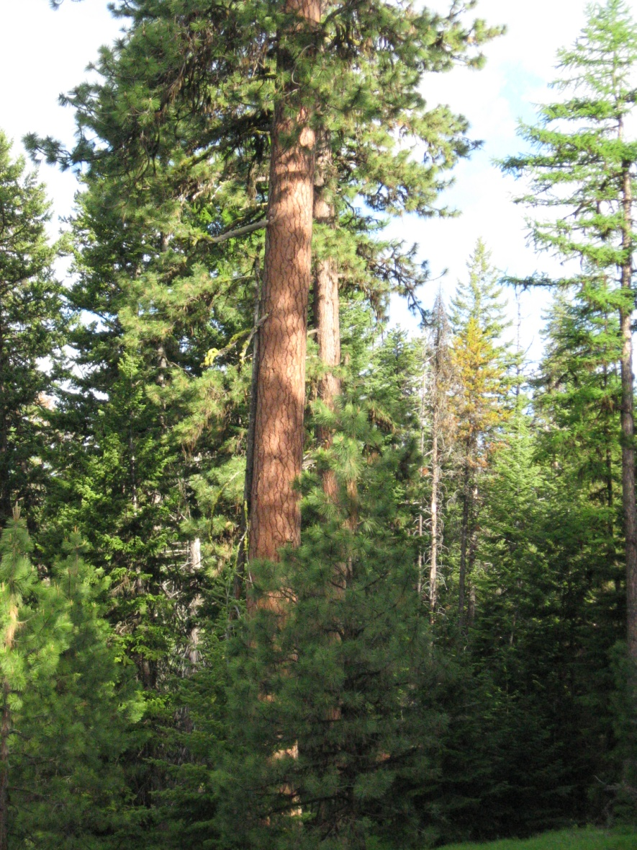
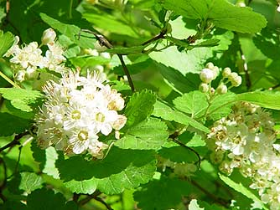
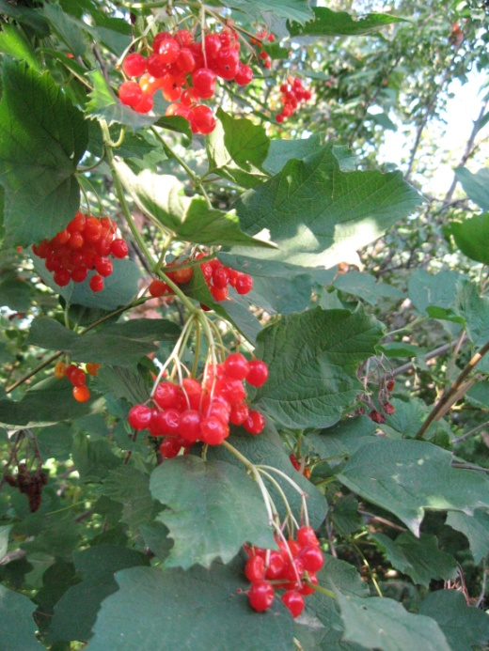
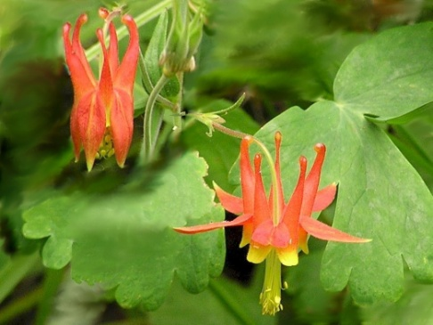
Sunny Forest Slopes
Notes:
Ponderosa Pine, Western Larch, golden currant, Pacific Ninebark and Columbine

Slide 22
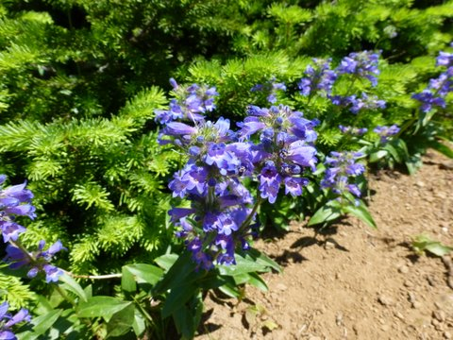
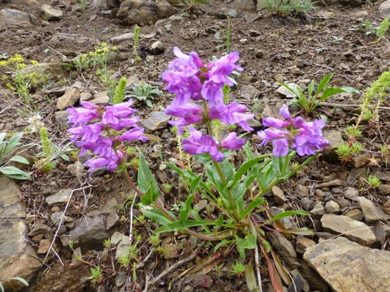
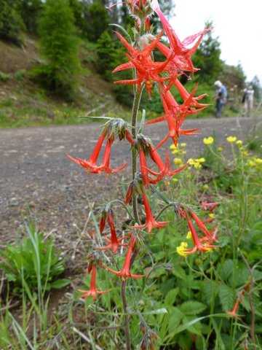
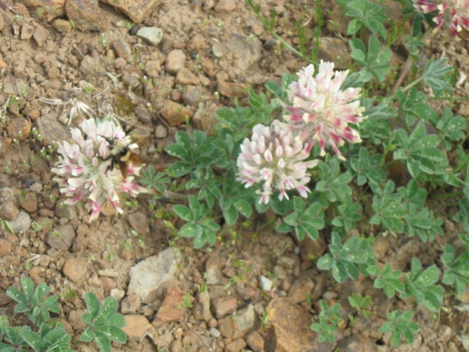
Sunny forest slopes and roadsides
Notes:
Scarlet Gilia, Blue Mt Penstemon and Shrubby Penstemon, Owl Clover

Slide 23
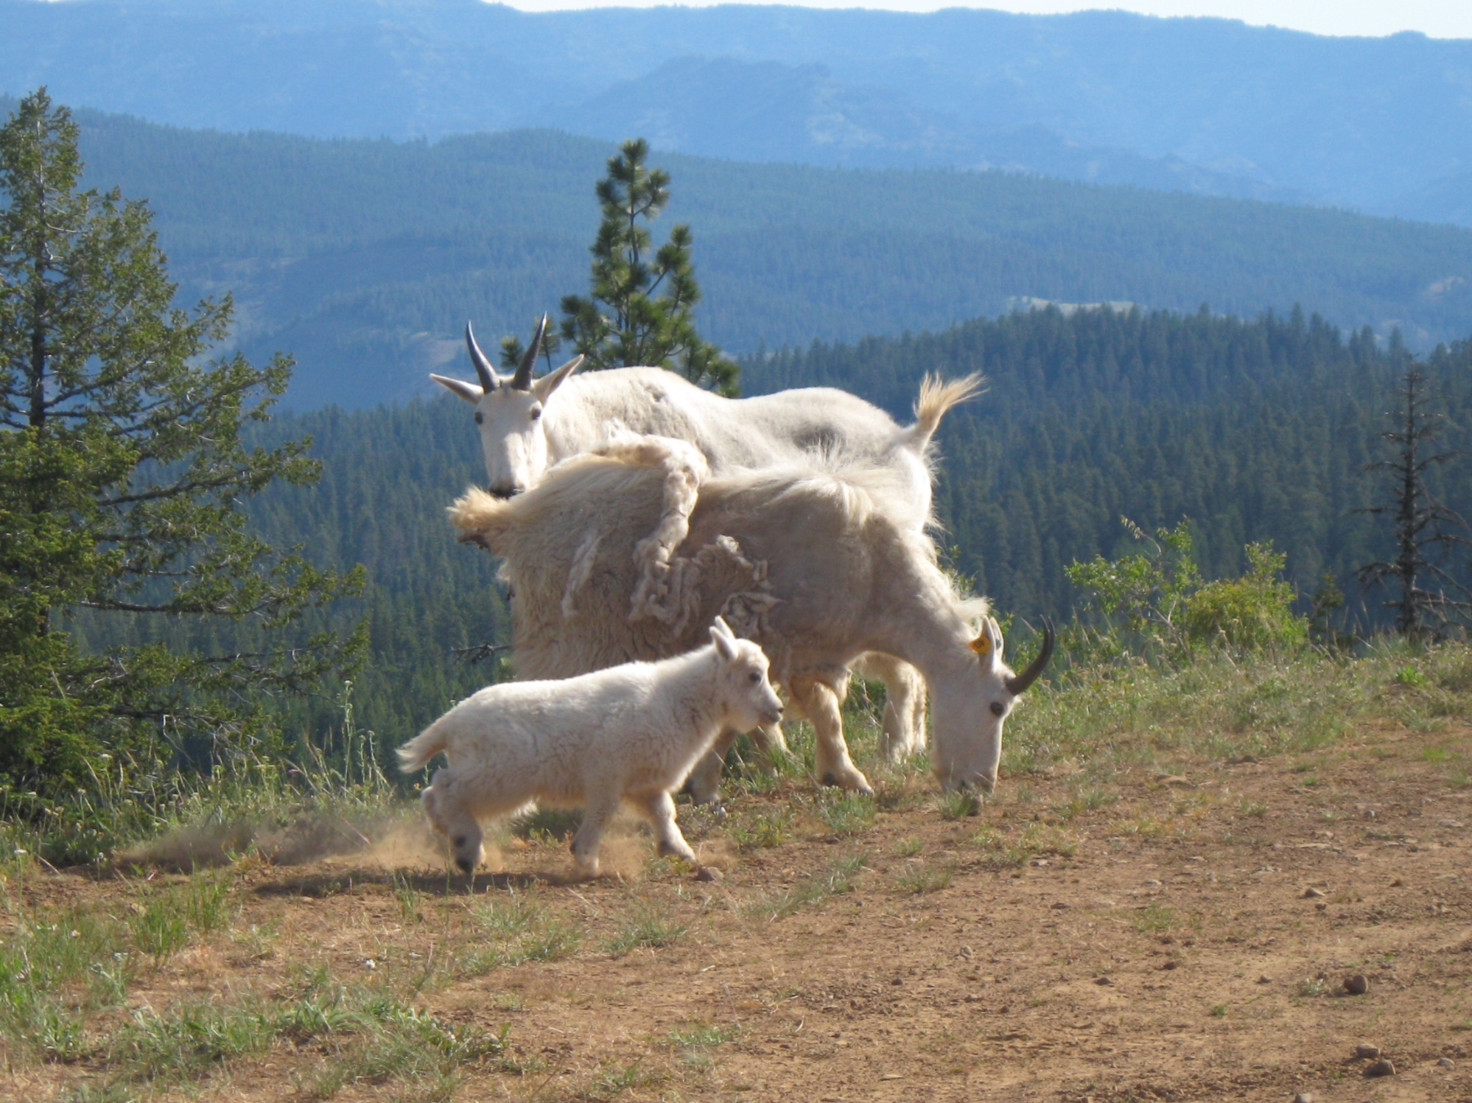
Notes:
Mountain Goats Rd 62 overlooking the Wenaha Wilderness

Slide 24
Why Use Native Plants?
Native Plants:
Are adapted to our climate of wet winters and hot, dry summers.
Once established, require less water and generally less maintenance than non-natives.
Improve water quality by needing less fertilizer and no pesticides.
Provide shelter, food and pollination opportunities for native wildlife.
Are beautiful
Notes:
These principles are illustrated by where one can locate native plants in the Walla Walla Watershed.

Slide 25
Landscaping with Native Plants
Identify goals for planting natives
Are you trying to reduce your water use?
Provides native habitat for wildlife?
Admire native plants in your garden?
Design to reduce effects of storm water runoff?
Notes:
When you begin to think about how to landscape with native plants –first identify goals.

Slide 26
How do I design a native plant garden?
Evaluate local conditions:
Is you soil sandy or shallow, rocky or deep?
Is the area in full sun all day or shaded part of the day?
Is there a watering system already in place?
If so, what type? Sprinkler, drip, hand or automatic.
Notes:
Next, evaluate conditions in the area that you will plant your garden.

Slide 27
Group plants by their needs.
Consider light, soil and water.
Keep in mind that perennial plants in Eastern Washington have deep roots.
Areas near streams are often rocky with little soil but a higher water table.
Learn the plant’s needs from where they grow naturally.
Include conifers, deciduous trees, shrubs, ground cover/grasses and wildflowers.
Notes:
Learn the needs of native plants and group them according to needs.

Slide 28
What native plants are best for a planting in Walla Walla
Plant List has most common and easily purchased plants.
Plants that do well in full sun and can tolerate drought if no supplemental water is available.
Plants that do well in full sun/partial shade that need supplemental water from July-October
Notes:
After you have established goals, evaluated soils and learned about the needs of native plants than group native plants.

Slide 29
Sun and Dry Soil
Rocky Mt. Juniper
Oak leaf sumac
Green rabbitbrush
Fringed Sage
Kinnickinnick
Wild Blue Flax
Ponderosa Pine
Mountain Ash
Snowberry
Wood’s Rose
Blue Mt Penstemon
Arrowleaf Balsam Root
Idaho Fescue
Purple Coneflower

Slide 30
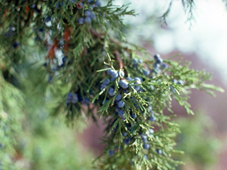
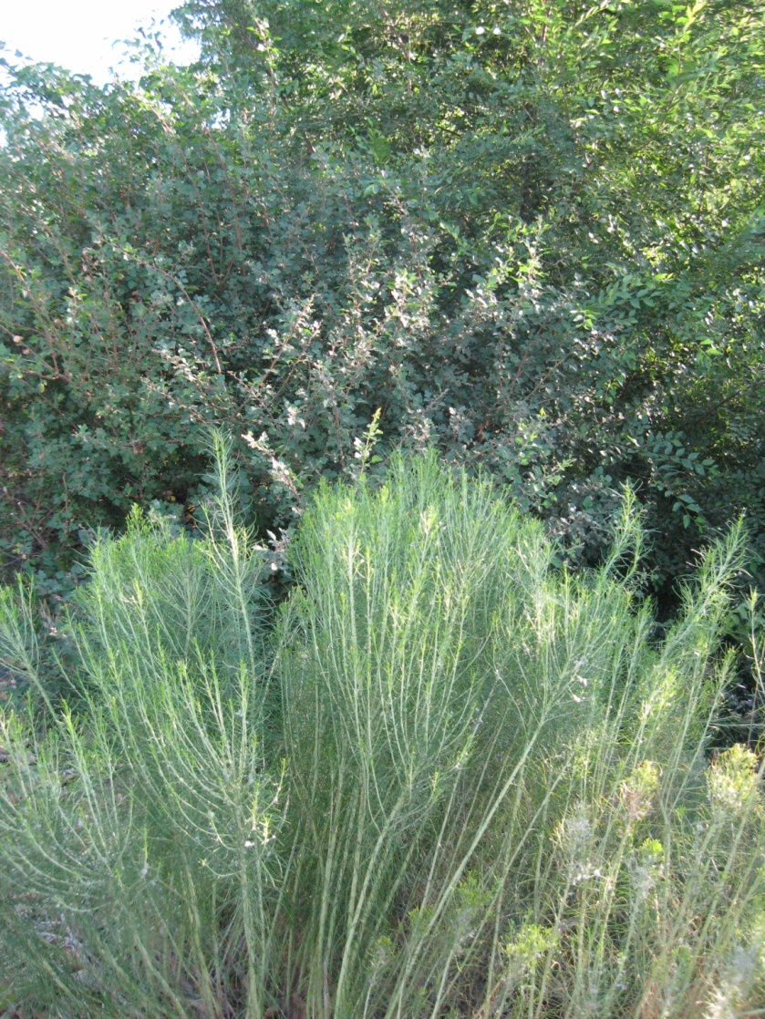
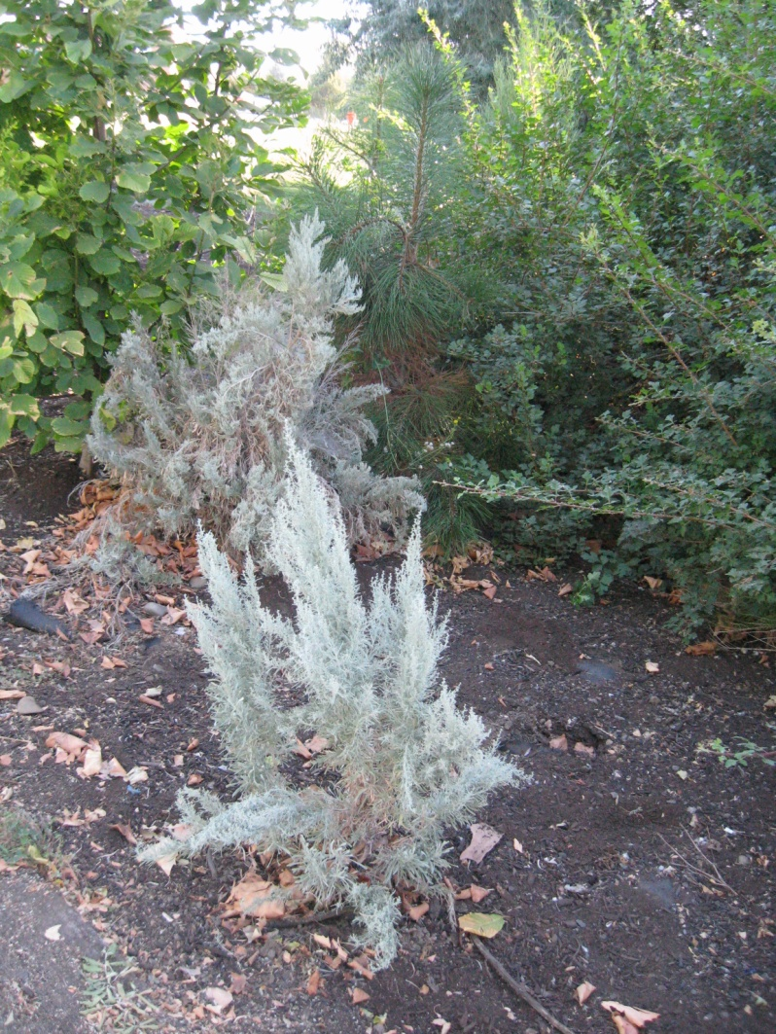
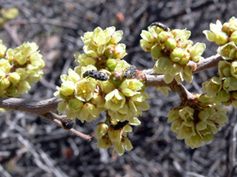
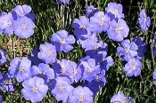
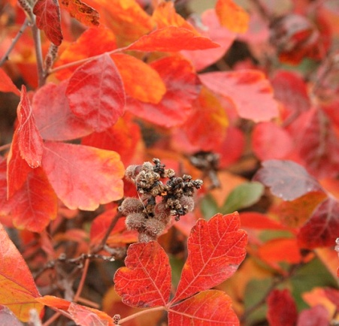
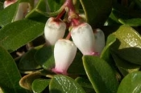
Notes:
Rocky Mt Juniper, Oak Leaf Sumac, Green Rabbitbrush, Fringed Rabbitbrush, Bitterbrush, Idaho Fescue

Slide 31
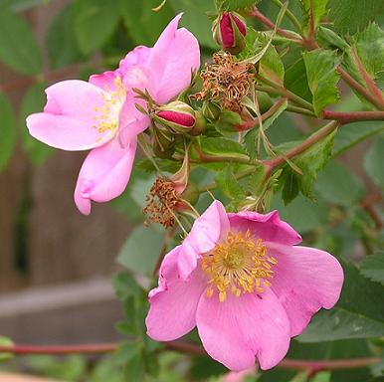
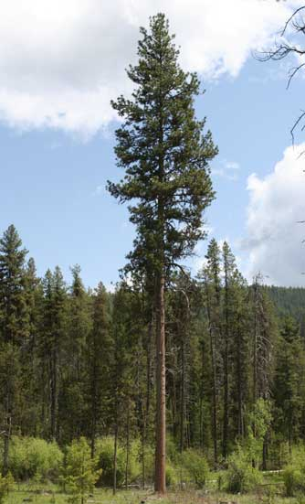
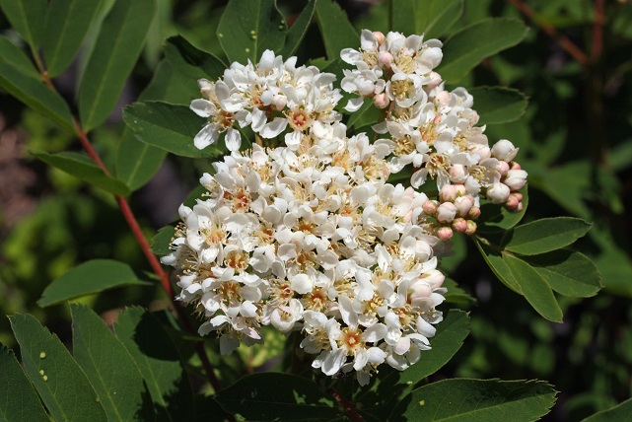
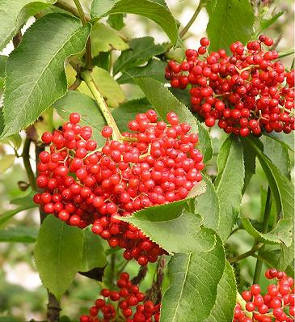
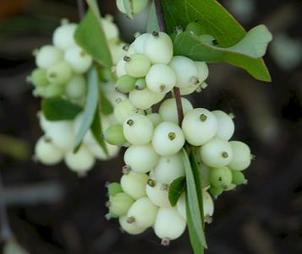
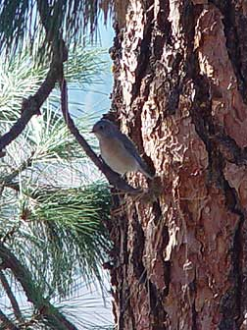
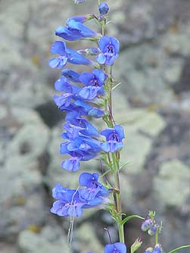
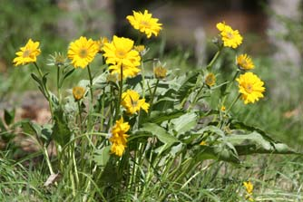
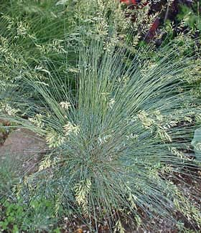
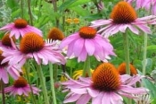
Notes:
Ponderosa Pine are drought and fire resistant and although this tree is probably 200-300 years old, they are also great trees for cavity nesting

Slide 32
Sun with Supplemental Moisture
Western Larch
Serviceberry
Bunchberry
Scouler Willow
Mock Orange
Douglas Fir
Quaking Aspen
Vine Maple
Huckleberry
Oregon Iris
Yellow Violet

Slide 33
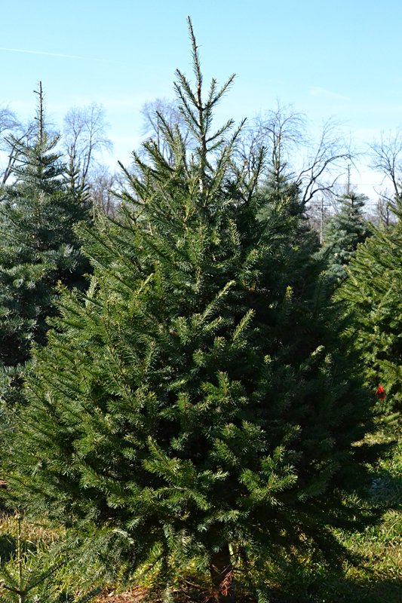
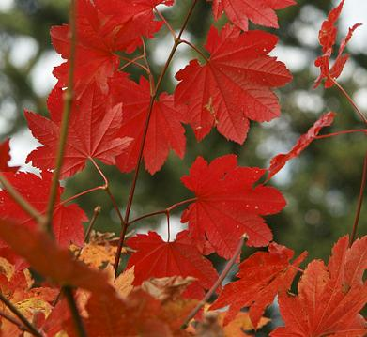
Notes:
Douglas Fir, Wood’s Violet, Vine Maple, Dwarf Huckleberry (Evergreen) Quaking Aspen, Oregon Iris

Slide 34
Notes:
Western Larch, Mock Orange, Bunchberry, Peony

Slide 35
Riparian Areas- Sun/Shade/Shallow Soils/Moist
Coyote Willow
Douglas Fir
Red Osier Dogwood
Quaking Aspen
Vine Maple
Huckleberry
Red Flowering Currant
Blue-eyed Grass
Water Birch
Engleman Spruce
White Alder
Cascara
Chokecherry
Douglas Spirea
Wild Strawberry

Slide 37
Notes:
Engleman spruce-usually found at high elevations but survives in moist soils at lower elevations –white alder long lasting deep rooted-bitter cherry white blossoms in spring-cascara-Douglas spirea

Slide 38
What Not to Plant-
Butterfly bush
Himalayan Blackberry
Indigo Bush
Yellow Flag Iris
Reed Canary Grass
Notes:
It forms dense thickets, especially along river banks and gravel bars, which crowd out native plants and may alter soil nutrient concentrations. This shrub is difficult to control, can produce seeds during its first year and seeds are viable 3 to 5 years

Slide 39
Notes:
Himalayan Blackberry It is a notorious invasive species in many countries around the world and costs millions of dollars for both control and in estimated impacts. This species spreads aggressively and has severe negative impacts to native plants, wildlife and livestock.
Indigo Bush Although native to the Eastern United States, in some Western states it is considered invasive and has naturalized. It escapes planted areas and grows along streams and rivers and prairie draws forming dense thickets and outcompetes native species. Toxic to humans and livestock.
Yellow flag iris is an invasive ornamental perennial that is a problem in many states and other countries. It will sicken livestock if ingested and is generally avoided by herbivores. Contact with its resins can cause skin irritation in humans.
Reed Canary Grass-It is a major threat to natural wetlands. It out competes most native species as it forms large, single-species stands, outcompeting other species. Dense stands have little wildlife habitat value. Its invasion can cause siltation in irrigation ditches.

Slide 40
Examples of Native Planting in Walla Walla and College Place
Yellowhawk Creek at Murr Field and WA-HI
Garrison Creek at Wilbur and Celestia Drive, Ruth Street, Walla Walla General Hospital
Stone Creek at Stone Street and Lamperti Street
Lincoln Creek at Catherine and Whitman Street
Bryant Creek on Palouse and L Streets
Russell Creek on Reser Road at Wilbur

Slide 41
When to plant natives
Dryland shrubs, perennials and grasses my be planted in the fall or spring.
For spring planting, plant as early as possible and provide water through spring to establish roots.
Supplement water for the first two years in dry summer and early fall months. (July-Oct)

Slide 42
Planting Natives-container grown
Dig a hole large enough to allow the roots to hang straight down without curling back up.
Fill the hole with water and let it drain.
Set the plant in the hole make sure the crown is at ground surface.
Fill the hole with soil and firm the soil around the roots.
A slight depression may be left around the plant to retain water. Water the plant.

Slide 43
Caring for Native Plants in the Garden
Provide the plant with water equivalent to that received in its natural habitat.
Conserve water by applying water with a drip line or-mini sprinkler system.
Period thinning may be used to maintain “order’’ if native species reseed more than desired.
After they are well established native shrubs may be pruned.

Slide 44
Information about Native Plants
Eastern Washington Native Plants
http://www.bentler.us/eastern-washington/plants/
Walla Walla County Native Plant Society
http://www.wnps.org/plant_lists/counties/walla_walla/walla_walla_county.html
The Wild Garden: Hansen's Northwest Native Plant Database
http://www.nwplants.com/business/catalog/indexPerennials.html
Washington State Noxious Weed Control Board
http://www.nwcb.wa.gov/

Slide 45
Finding Native Plants for Your Garden
Please do not collect plants from the wild.
Ask the nursery if their plants are from local seed stock.
Be aware of non-native plants that may be listed as noxious weeds and avoid using them.

Slide 46
Where to purchase native plants
CTUIR Tribal Native Plant Nursery-Locally Collected, Locally Adapted Native Plants
Confederated Tribes of the Umatilla Indian Reservation
Gail Redberg, Manager
Office (541) 278-8525 fax (541) 429-8560.
www.tribalnativeplants.com/
Wildlands Nursery -Propagates and sells healthy plants adapted to Eastern Washington.
68911 River Road Benton City, WA. 99320
Anne Meisinger or Ryan Watts
(509) 588-4328
www.wildlandsnursery.com/
Plants of the Wild 123-Plants adapted to NE Washington that also do well in Walla Walla.
123 Stateline Road Tekoa, WA 99033
Kathy Hutton or Carrie Garcia
(509) 284-2848
www.plantsofthewild.com/
‎

